Slide 1
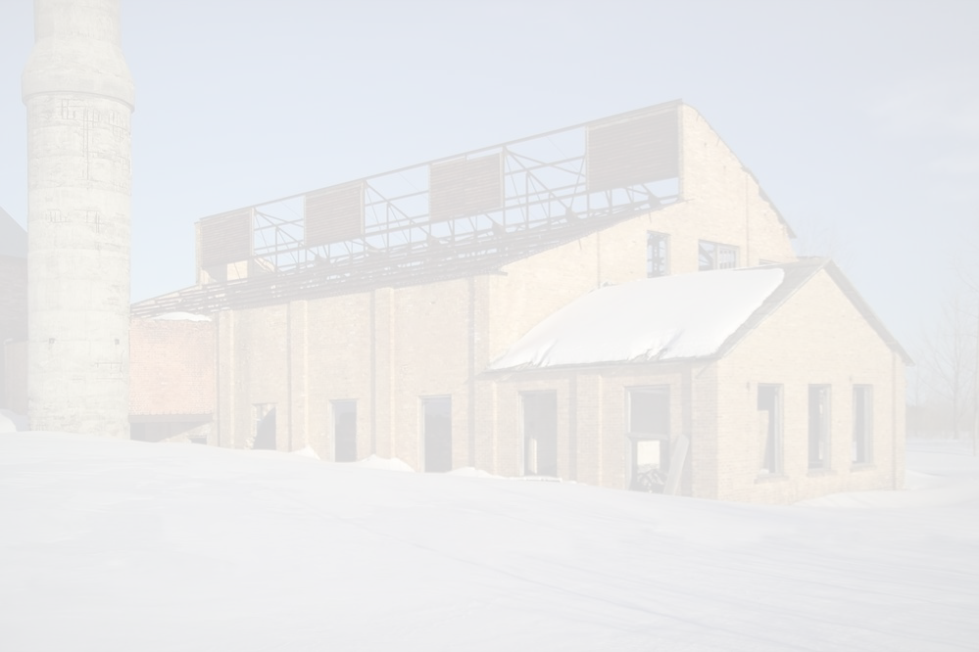


Quincy Mine Hoist Association
Boiler House #5 & Machine Shop Restoration
Midwest Structural Builds
Cole LeBarre Logan Stein Mason Chapman Wyatt Brown
04/27/2020
1

Slide 2

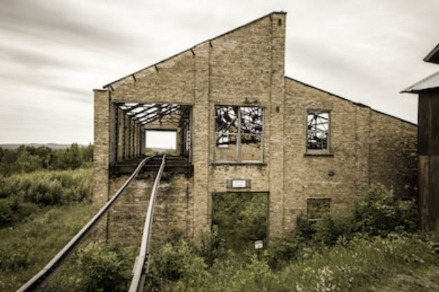
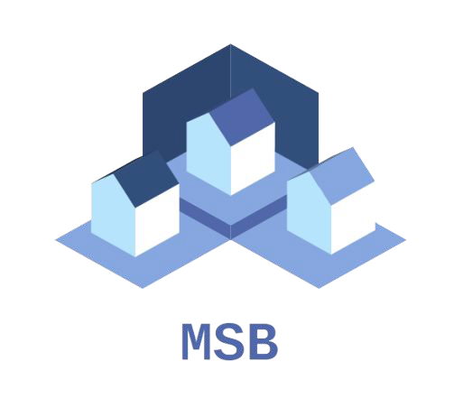
Overview
Project Outline
Site Visit
Design Process
Construction Schedule
Cost Analysis
Next Steps
Summary
Questions
Logan Stein
04/27/2020
2

Slide 3
Project Outline
Work with Quincy Mine Hoist Association
Vision: Preserve Quincy Mine’s historical resources
Solution: Renovate Boiler House #5 & Machine Shop
Restore both buildings to be historically accurate
  Keeping overall cost and timeline in mind
Wyatt Brown
04/27/2020
3

Slide 4
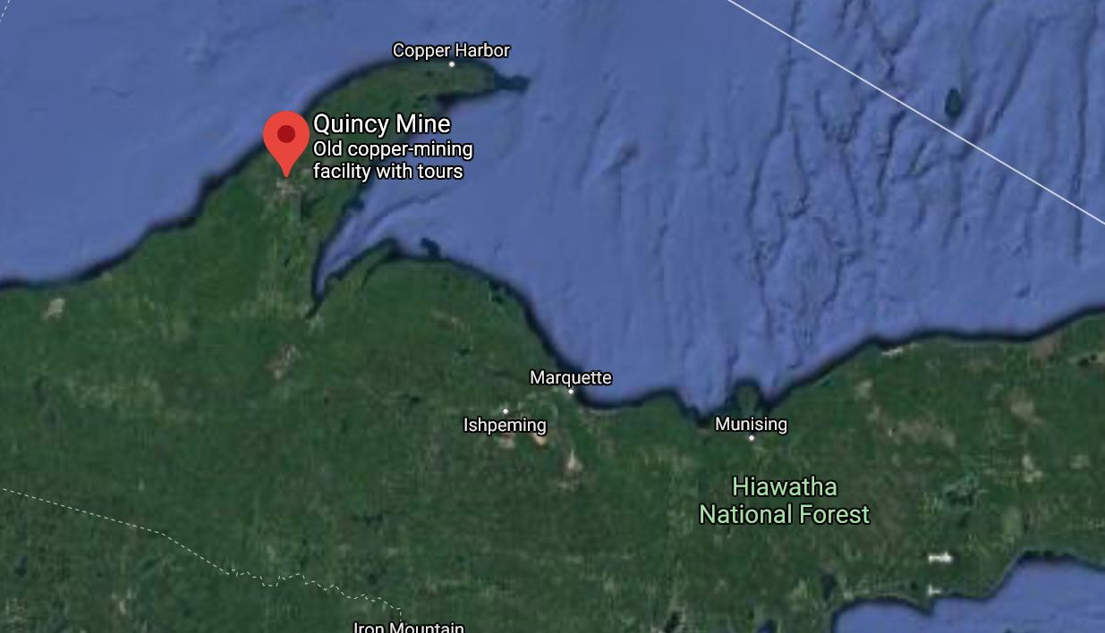
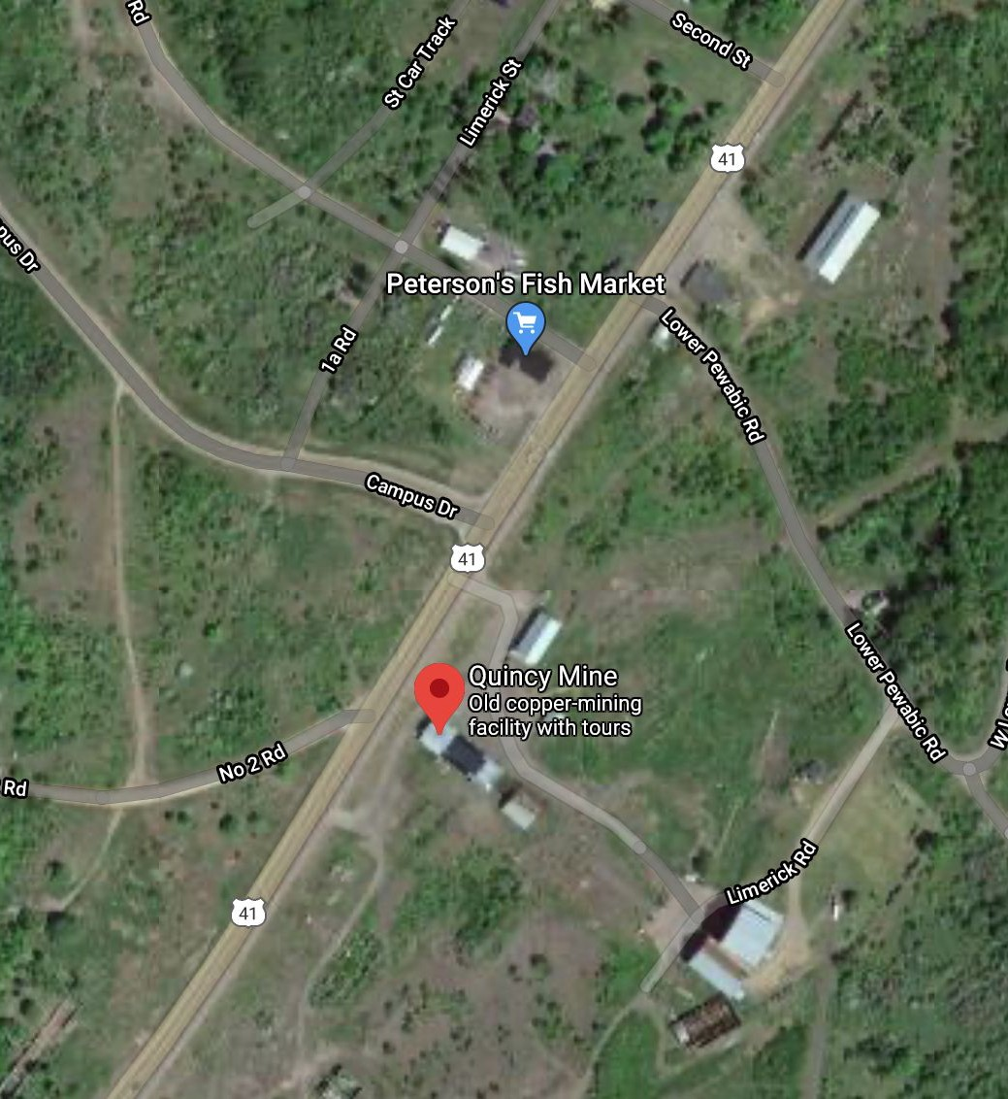
Project Location
Cole LeBarre
4

Slide 5
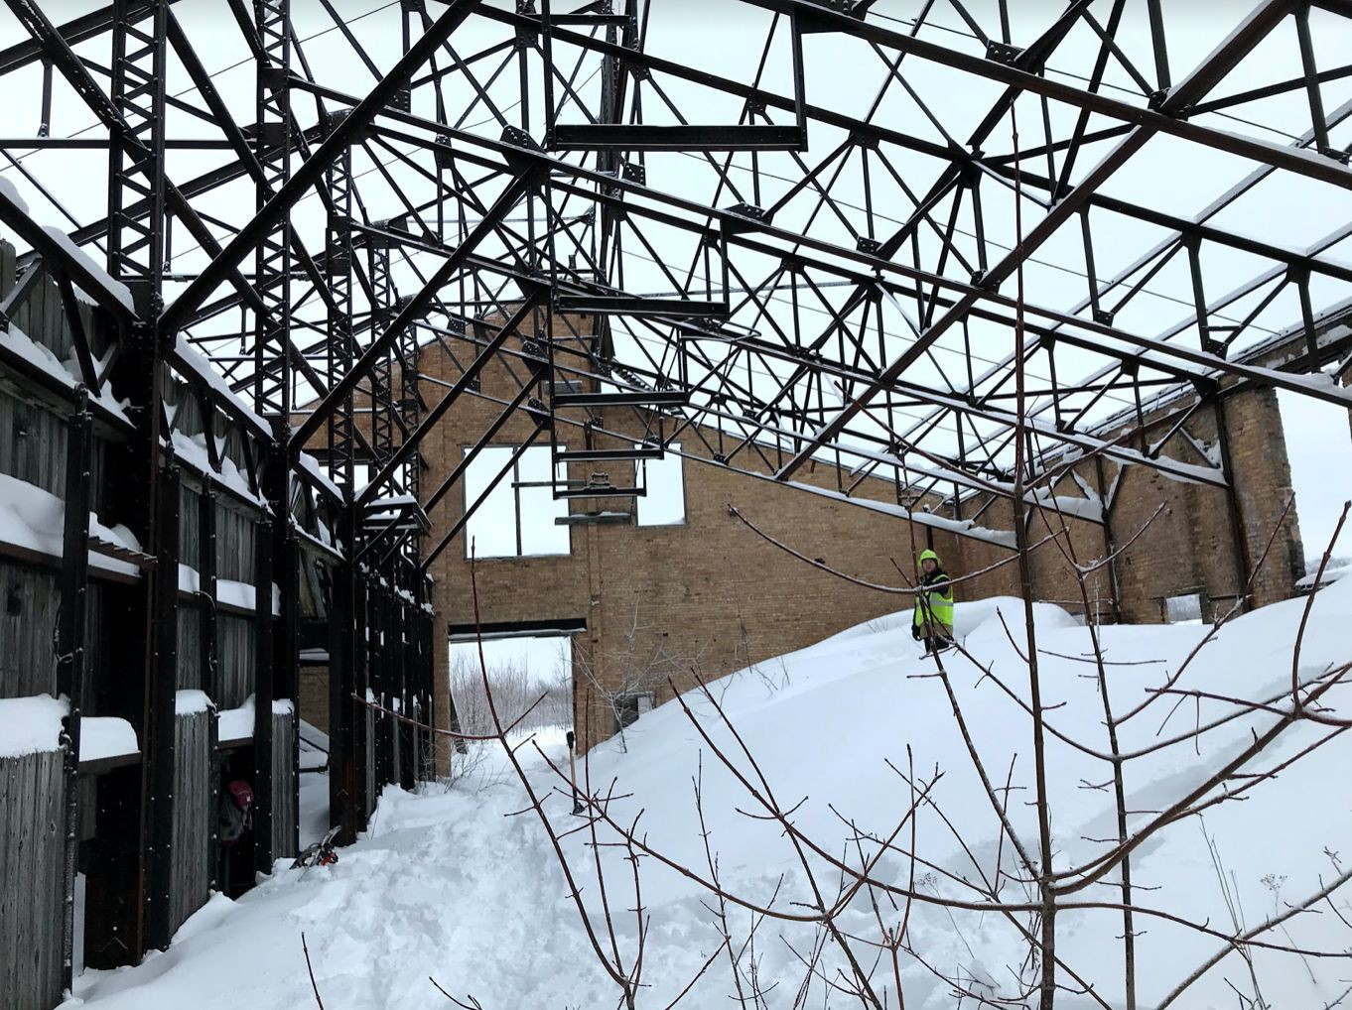
Site Visit
First Site Visit
  Learn how to access site
  Cleared snow
  Created list of items to restore
  Initial Measurements of Building
Second Site Visit
  Continued measurements
  Pictures of trusses/building
  Trestle measurements
Cole LeBarre
5

Slide 6
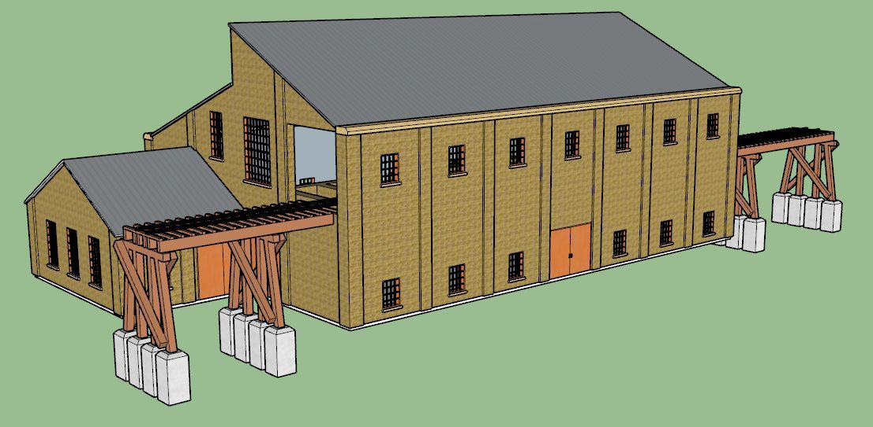
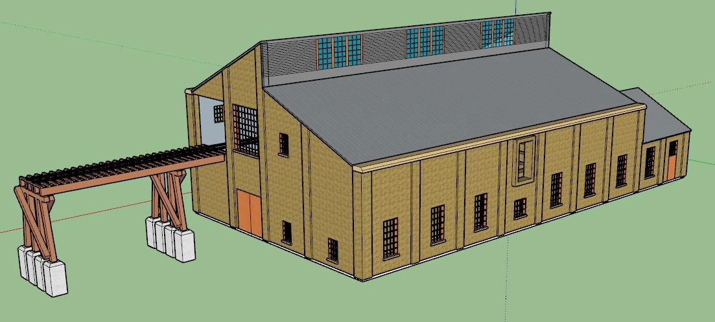
Design Process - Concept
Cost Saving with Historic Accuracy
  Ability to save money by using modern technology
  Ability to obtain material quicker
Maintain historical accuracy
Machine Shop
  Concrete and Wood Planks
Wyatt Brown
04/27/2020
6

Slide 7
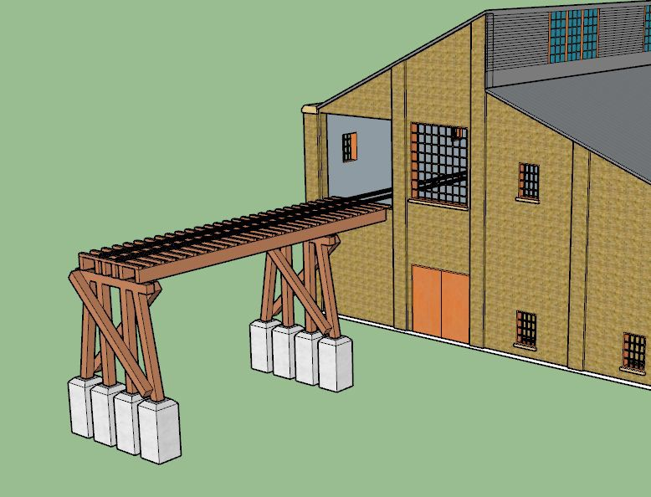
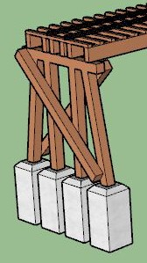
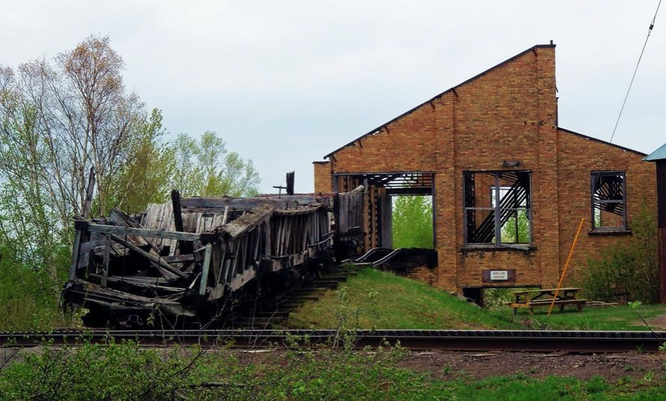
Design - Trestle
Total Span = 54’
Total Load per section = 5800 #
AWC - NDS for Wood Construction
  Total Section Cap. = 170,000
Allows Cart use
#
Logan Stein
7

Slide 8
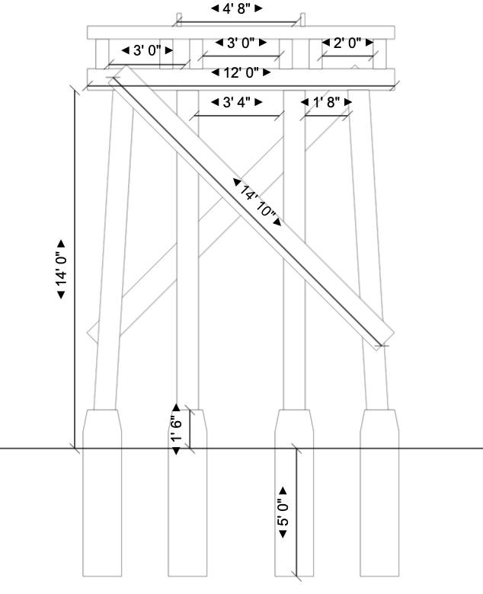
Design - Trestle Footings
18” wide
18” exposed above ground
60” underground
  12” past frost line
Footing Capacity = 970,000 #
Sandy-Gravel = 30,000 #
  Governs load
Logan Stein
8

Slide 9
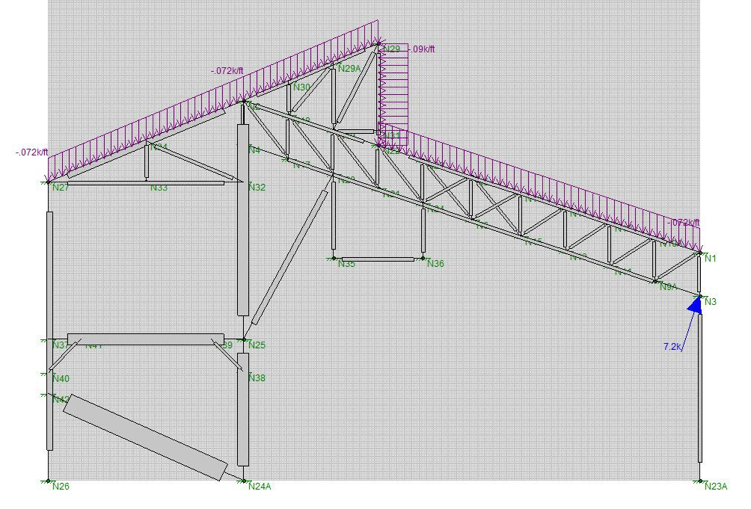
Design - Truss Analysis
Loading
  ATC Hazards by location
  Dead+Snow+Wind governs
Steel Code
  RISA3D checks steel code
  All steel is up to code specs
  Truss resists all loading eﬀectively to continue with roof replacement.
Cole LeBarre
9

Slide 10
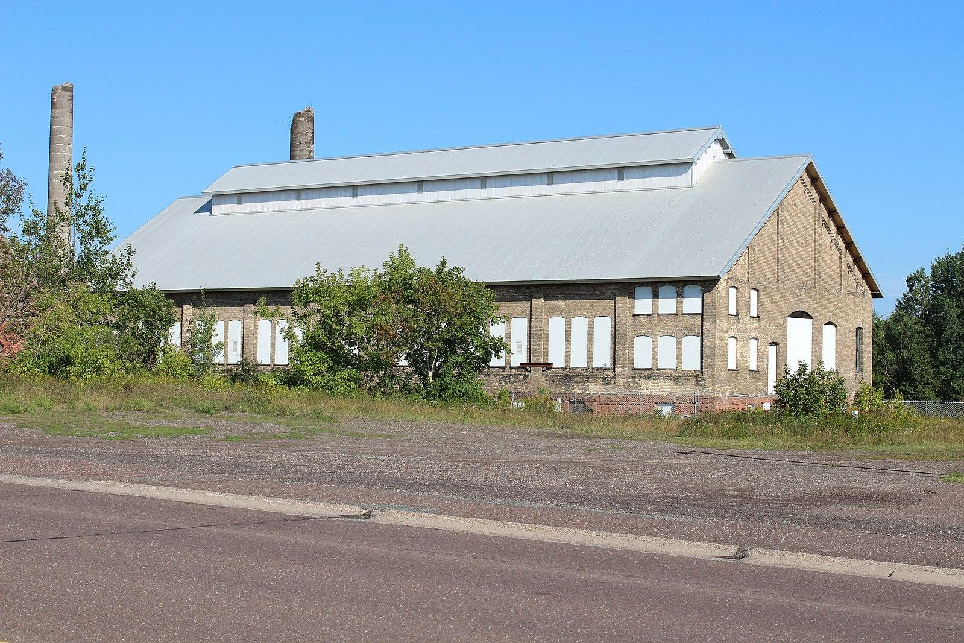
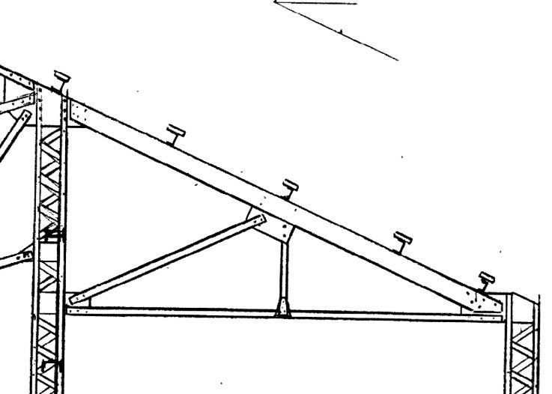
Design - Roof System
Stringers
  2”x8”x12’
Steel Rooﬁng
  Match Machine Shop as closely as possible
  Was originally a tin roof
Cole LeBarre
10

Slide 11
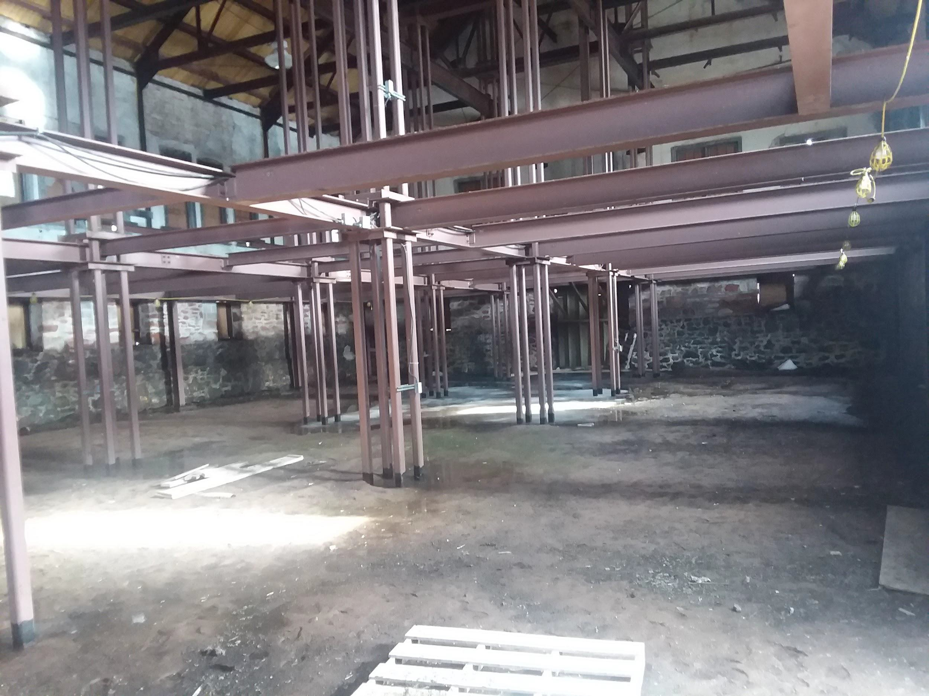
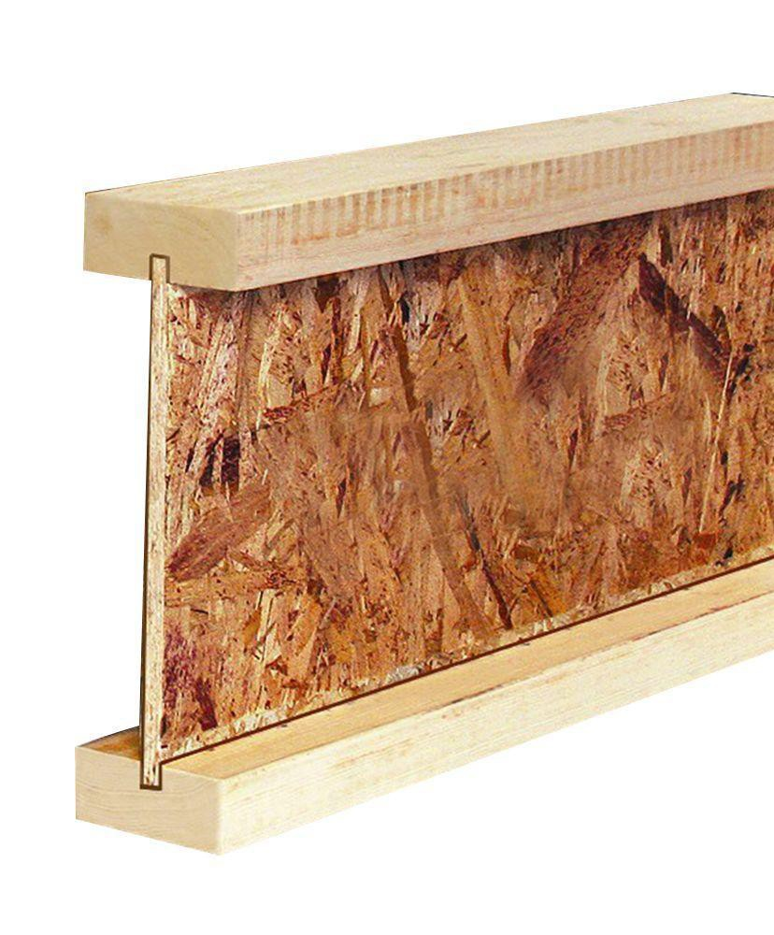
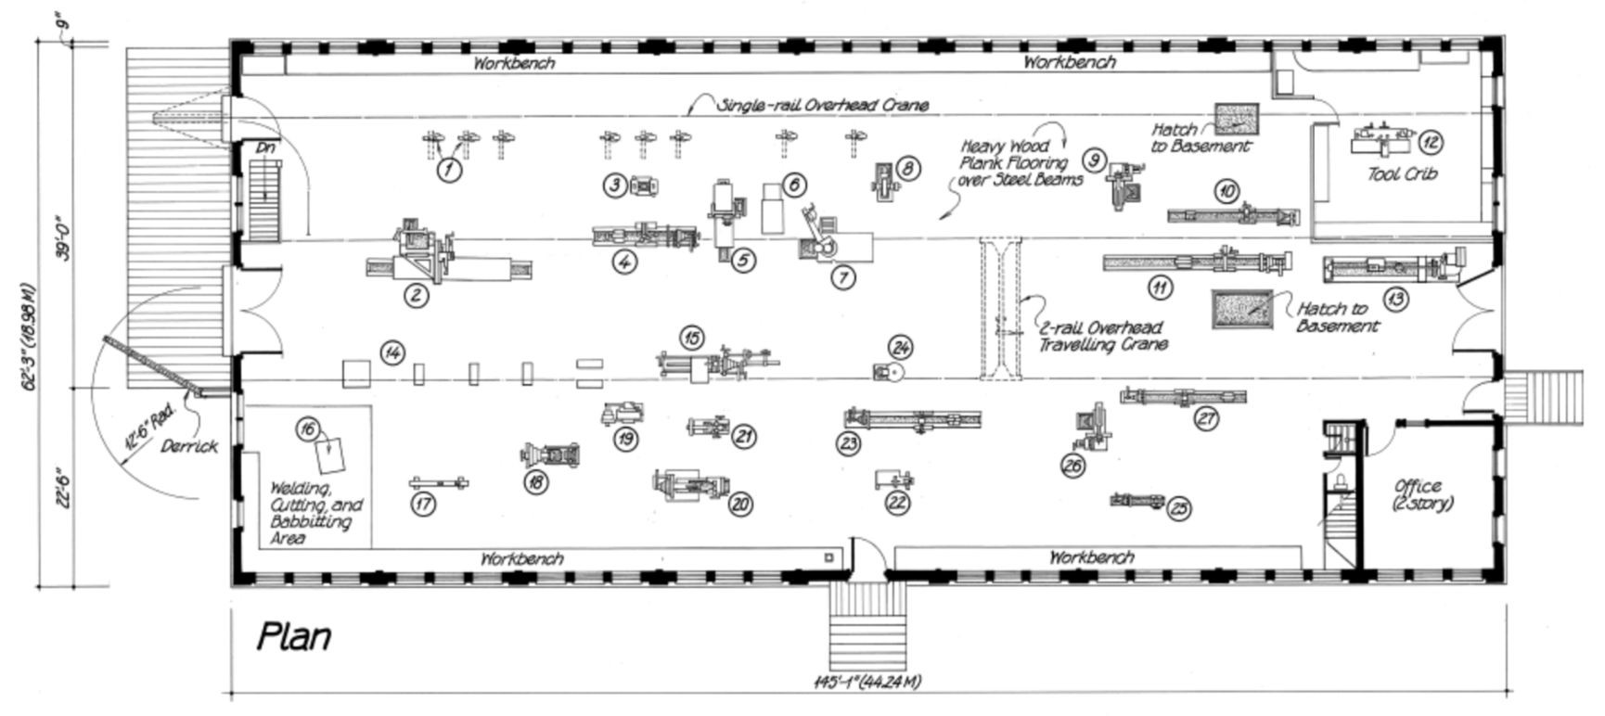
Design - Machine Shop Floor
American Wood Council Span Calculator
GPI 40 wood joist
  16” on center
  16’ span with 40 psf LL + 10 psf DL
  Allows for static displays of machinery
2” x 6” x 12’ decking
Logan Stein

Slide 12
Construction Schedule
Best route for construction is in phases
  Four phases in total
  Tentatively scheduled a year apart: Start Spring 2021- Finish late Spring 2024
  Designed to hold tour in prime Summer months
Order of phases based on importance and structural integrity
  Follows typical construction (Permits → Clearing → Concrete)
Mason Chapman

Slide 13
Cost Analysis
Phase 1: | $25,000
Phase 2: | $45,000
Phase 3: | $70,000
Phase 4: | $140,000
Contingency- 10%: | $28,000
Overhead & Profit | $77,000
Total: | $385,000
Total cost is about $385,000 with a 10% contingency.
This includes all material, equipment
and labor throughout the phases of this project
All estimates are maximum as some material can be reused
Wyatt Brown

Slide 14
Cost Analysis- Phase 1
Roof- Wood stringers on top of trusses and a pro-rib style steel sheet
Phase 1:
Roof: | $25,000
Total: | $25,000
Wyatt Brown

Slide 15
Cost Analysis- Phase 2
Site Work- Clearing debris, shrubs and trees
Concrete Slabs- Both rooms in the
Boiler Plant and in the Machine Shop
Phase 2:
Site Work: | $5,000
Concrete Slabs: | $40,000
Total: | $45,000
Wyatt Brown

Slide 16
Cost Analysis- Phase 3
Doors- Two custom doors in the front and side of building
Steel Replacement- Replacing rusted
out steel under the rail system
Windows- Replacing damaged frames with complete windows
Phase 3:
Doors: | $1,500
Steel Replacement: | $3,500
Windows: | $65,000
Total: | $70,000
Wyatt Brown

Slide 17
Cost Analysis- Phase 4
Brick Work- Demolish boiler walls and use those bricks for rebuild
Windows- Replacing remaining
damaged frames with complete windows
Miscellaneous Allowance
Machine Shop- Floor System
Trestle- Full restoration of the railroad trestles on the front of the building
Phase 4:
Brick Work: | $51,000
Windows: | $50,000
Allowance: | $7,500
Machine Shop: | $11,000
Trestle: | $20,500
Total: | $140,000
Wyatt Brown

Slide 18
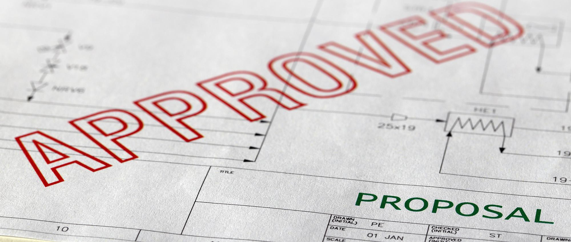
Next Steps
Obtain funding
Work with a licensed engineer
Get needed permits
Determine winterizing and maintenance schedule
Start construction
Mason Chapman

Slide 19
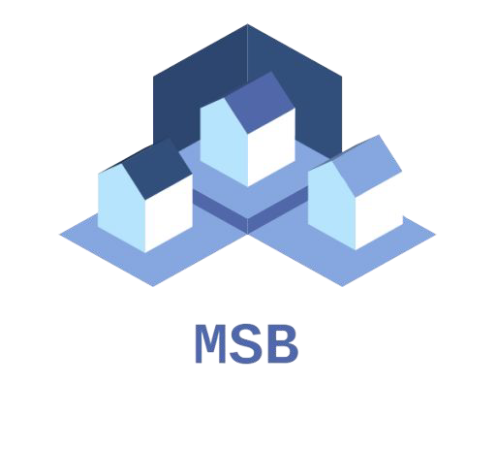
Summary
Project Outline
  Renovate Boiler House & Machine Shop
Site Visit
  Created list of items to renovate & took initial measurements
Design Process
  Structurally sound and historically accurate
Construction Schedule
  Four phases starting spring 2021
Cost Analysis
  Total cost of approx. $385,000
Next Steps
  Funding, engineer, permit, etc.
Mason Chapman

Slide 20

Acknowledgements
David Nelson
Dr. Theresa Ahlborn
Glenda Bierman
George Kiiskila
Logan Stein
04/27/2020
20

Slide 21
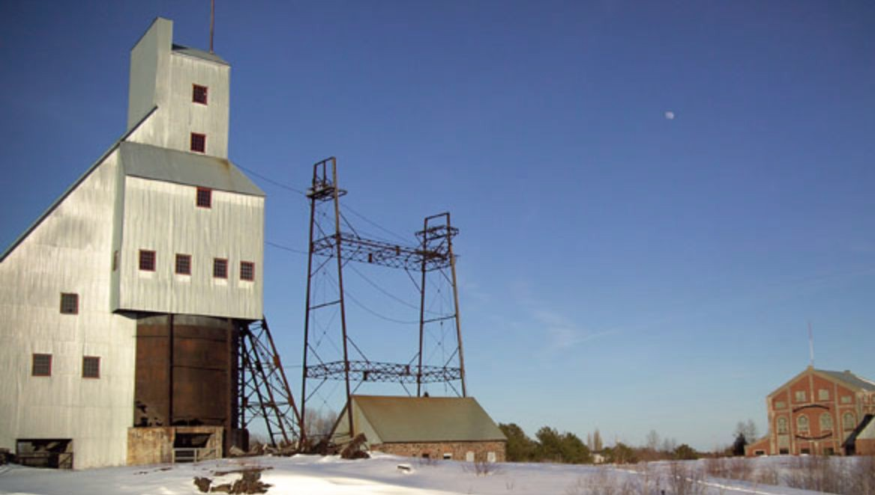
Questions
21

